Slide 1

DATA ANALYTICS & BUSINESS INTELLIGENCE PROJECT
HOTEL BOOKING
ANALYSIS
Revenue · Marketing · Cancellations · Customer Behavior
PRESENTED BY
Karima Saad · Nourhan Wael · Elsayed Elsawaf
Walid Nofal · Hana Mohamed · Eman Elnahas

Slide 2




01
/ 06
KARIMA SAAD
Project Overview · Data Source · Python Exploration + Cleaning
From raw hotel bookings to an analysis-ready dataset

Slide 3
01 · INTRODUCTION
Project Overview
This project analyzes ~117,000 bookings across City Hotel and Resort Hotel (2015–2017) to surface revenue, marketing, cancellation, and customer behavior patterns.
117K
2015...2017
2
36
BOOKING RECORDS
TIME WINDOW
HOTEL PROPERTIES
FIELDS PER BOOKING
ANALYSIS PILLARS
Revenue Analysis · Booking Analysis · Cancellation Analysis · Marketing Analysis · Customer Behavior
END-TO-END PIPELINE
Data Source
Python
Exploration
Data
Cleaning
Feature
Engineering
SQL
Analysis
Dashboards
Business
Insights
Hotel Booking Analysis · Data Analytics Project
02

Slide 4
02 · DATA
Data Source & Dataset
Two CSV artifacts anchor the project: the raw hotel_booking.csv and the cleaned hotel_bookings_cleaned.csv. Together they hold ~117,000 records with 36 fields each, grouped below by analytic domain.
Stay Details
Guest Details
Booking / Marketing
Financial
Outcome
· lead_time
· arrival_date
· weekend_nights
· week_nights
· room_type
· adults
· children
· babies
· country
· repeat_guest
· market_segment
· distribution_channel
· deposit_type
· booking_changes
· ADR
· agent
· company
· special_requests
· is_canceled
· reservation_status_date
Hotel Booking Analysis · Data Analytics Project
03

Slide 5
03 · PYTHON
Data Exploration
import pandas as pd
import numpy as np
import matplotlib.pyplot as plt
import seaborn as sns
df = pd.read_csv('hotel_booking.csv')
df.head()
df.tail()
df.shape # (119390, 36)
df.info()
df.describe()
read_csv
Load the raw booking CSV into a DataFrame.
head / tail
Inspect first and last rows for structure.
shape
Confirm record and column counts.
info
Data types and non-null counts per column.
describe
Summary statistics for numeric fields.
Hotel Booking Analysis · Data Analytics Project
04

Slide 6
04 · PYTHON
Data Cleaning
df.duplicated().sum()
df.isnull().sum()
df.drop(columns=['company'], inplace=True)
df['agent'] = df['agent'].fillna(0).astype(int)
df['country'] = df['country'].fillna('Unknown')
df['children'] = df['children'].fillna(0).astype(int)
df.drop(columns=['name','email',
'phone-number','credit_card'],
inplace=True)
df['reservation_status_date'] = pd.to_datetime(
df['reservation_status_date'])
df = df[(df['adults']+df['children']+df['babies'])>0]
df = df[(df['adr']>0) & (df['adr']<5000)]
df.reset_index(drop=True, inplace=True)
01
Check duplicates & missing values
02
Drop 'company' (excessive nulls)
03
Fill 'agent' with 0
04
Fill 'country' with 'Unknown'
05
Fill 'children' with 0
06
Drop PII: name, email, phone, credit_card
07
Cast 'children' & 'agent' to int
08
Parse 'reservation_status_date' → datetime
09
Remove zero-guest rows
10
Filter ADR ∈ (0, 5000)
11
Reset index
Hotel Booking Analysis · Data Analytics Project
05

Slide 7
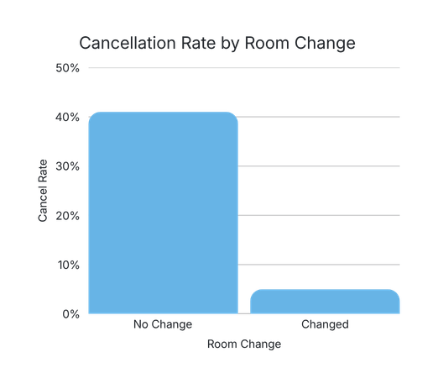
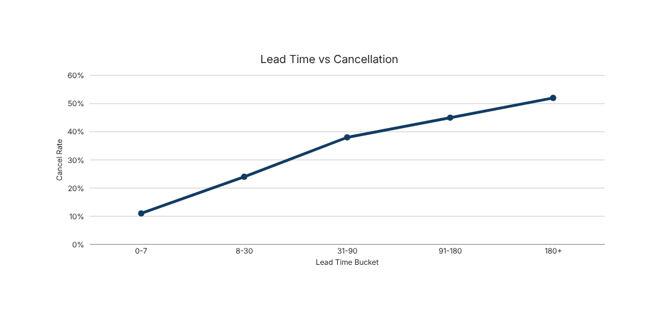
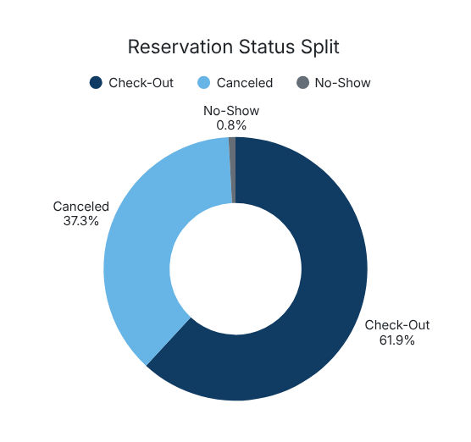
05 · PYTHON
Feature Engineering & EDA Visualizations
NEW FEATURES
total_stay
weekend_nights + week_nights
total_guests
adults + children + babies
reservation_year
extracted from reservation_status_date
reservation_month
extracted from reservation_status_date
room_type_changed
reserved != assigned room type
Longer lead times correlate with higher cancellation risk.
Hotel Booking Analysis · Data Analytics Project
Cancellations run ~37.5% of all bookings.
06

Slide 8





02 / 06
NOURHAN WAEL
SQL Query 1 • Revenue Analysis + Dashboard
From cleaned bookings to realized and lost revenue

Slide 9
06 · SQL
SQL Analysis Workflow
SQL complements Python: cleaned data is loaded into a SQL environment where aggregations, window functions, and joins power KPIs that feed the dashboards.
Cleaned Data
SQL Queries
Business Metrics
Dashboards
Insights
-- 1_Revenue Query.sql
SELECT hotel,
SUM((stays_in_weekend_nights + stays_in_week_nights) * adr)
AS total_revenue
FROM hotel_bookings_cleaned
WHERE is_canceled = 0
GROUP BY hotel
ORDER BY total_revenue DESC;
QUERY 1 — REVENUE ANALYSIS
Establishes hotel-level revenue baselines, ADR seasonality, and lost revenue impact.
Hotel Booking Analysis · Data Analytics Project
07

Slide 10
07 · SQL QUERY 1
Revenue — Business Questions
Q1
Total revenue by hotel
-- Sql/1_Revenue Query.sql
-- Total revenue by hotel
SELECT hotel, SUM(...) AS total_revenue ...
-- Average ADR by month
SELECT arrival_date_month, AVG(adr) ...
-- Lost revenue by month
SELECT arrival_date_month,
SUM((weekend+week)*adr) AS lost_revenue
WHERE is_canceled = 1 ...
-- Top 5 countries by revenue
SELECT TOP 5 country, SUM(...) ...
GROUP BY country ORDER BY revenue DESC;
Q2
Average ADR by month
Q3
Lost revenue by month (cancellations)
Q4
Average ADR by market segment
Q5
Hotel revenue and average lead time
Q6
Revenue and booking count by meal plan
Q7
Top 5 countries by revenue
Hotel Booking Analysis · Data Analytics Project
08

Slide 11
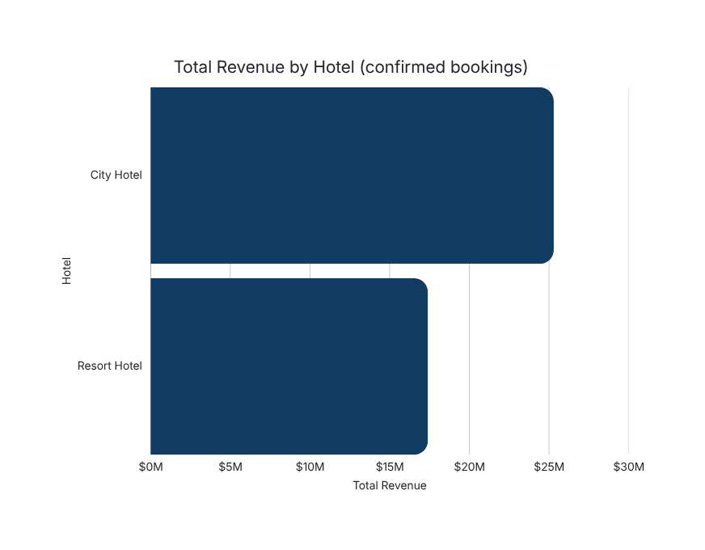

07 · SQL QUERY 1
Total Revenue by Hotel
SELECT hotel,
SUM((stays_in_weekend_nights + stays_in_week_nights) * adr)
AS Total_Revenue
FROM hotel_bookings_cleaned
WHERE is_canceled = 0
GROUP BY hotel
ORDER BY Total_Revenue DESC;
FORMULA
Total Revenue = (weekend_nights + week_nights) × ADR · filtered to is_canceled = 0
KEY OBSERVATION
City Hotel outperforms Resort Hotel on realized revenue, driven by higher booking volume despite comparable ADR.
Hotel Booking Analysis · Data Analytics Project
09

Slide 12

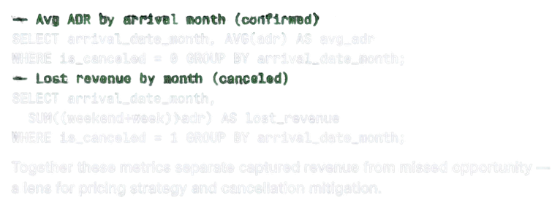

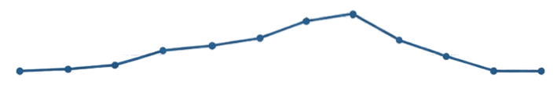


07 · SQL QUERY 1
ADR & Lost Revenue by Month
Lost — Revenue from Cancellations by Month
Realized — Average ADR by Month
Q4 — Average ADR by Market Segment
SELECT market segment, Avg(adj) AS Average_ADR
WHERE is(cancelled = 0
GROUP BY market segment
ORDER BY Average ADR BESC,
Q4 — Average ADR by Market Segment
This query compares the average daily rate across market segments for confirmed bookings, highlighting which segments command higher ADR and informing targeted pricing and segmentation strategies.
Hotel Booking Analysis - Data Analytics Project
12

Slide 13
















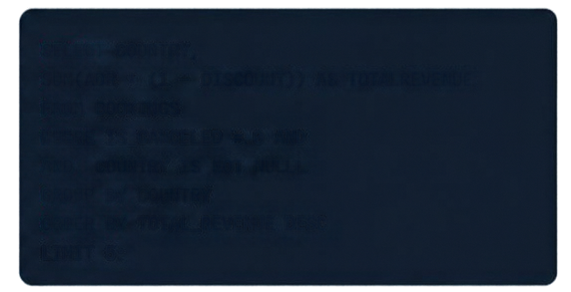
07 • SQL QUERY 1
Revenue Analysis • Q5–Q7
Q5. Hotel Revenue Plus Average Lead Time
Q6. Revenue and Booking Count by Meal Plan
Q7. Top 5 Countries by Revenue
Using confirmed bookings only, calculate total revenue and average lead time (days) by hotel.
Using confirmed bookings only, calculate total revenue and number of bookings by meal plan.
Using confirmed bookings only, exclude null countries and return the top 5 countries by total revenue.
Returns:
✔ Hotel
✔ Average_Lead_Time_Days
✔ Total_Revenue
Returns:
✔ Meal
✔ Total_Revenue
✔ Number_Of_Bookings
Returns:
✔ Country
✔ Total_Revenue
SELECT HOTEL,
_AVG(AVERAGE_LEAD_TIME_DAYS) AS AVERAGE_LEAD_TIME_DAYS, SUN(ADR * (1 - DISCOUNT)) AS TOTALREVENUE, COUNT (*) AS NUMBER_OF_BOOKINGS
FROM BOOKINGS
WHERE IS CANCELED = 0 AND
GROUP BY HOTEL
ORDER BY TOTAL_REVENUE DESC,
SELECT MEAL,
SUM(ADR * (1 - DISCOUNT)) AS TOTALREVENUE, COUNT (*) AS NUMBER_OF_BOOKINGS
FROM BOOKINGS
WHERE IS CANCELED = 0 AND
GROUP BY MEAL
ORDER BY TOTAL_REVENUE DESC;
SELECT COUNTRY,
SUM(ADR * (1 - DISCOUNT)) AS TOTALREVENUE, FROM BOOKINGS
WHERE IS CANCELED = 0 AND
AND COUNTRY IS NOT NULLL
GROUP BY COUNTRY
ORDER BY TOTAL_REVENUE DESC
LIMIT 5;
07 • SQL QUERY 1

Slide 14
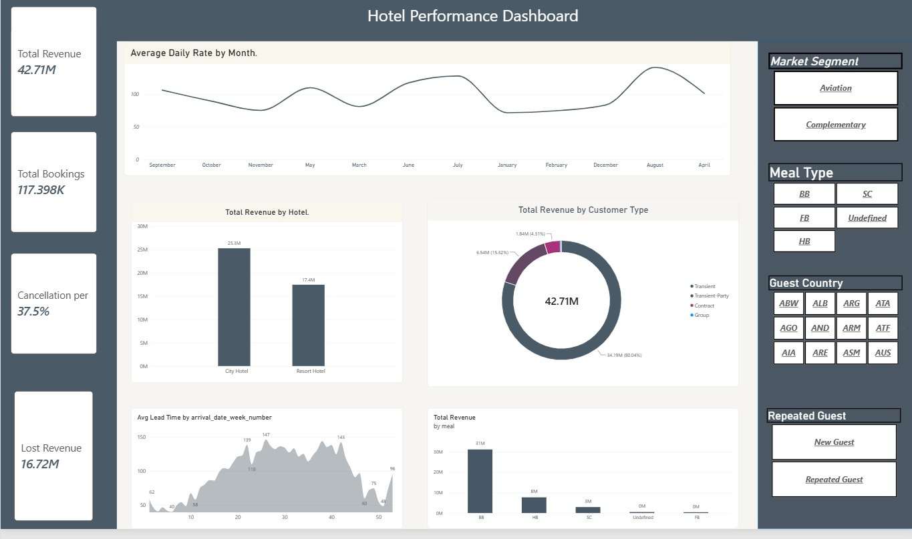
07 · POWER BI
Revenue / Hotel Performance Dashboard
11

Slide 15
07 · SQL QUERY 1
Revenue — Key Findings
OBSERVED DATA
BUSINESS INTERPRETATION
→ City Hotel generates higher realized revenue than Resort Hotel.
→ Cancellations account for ~$16.72M in lost revenue across the dataset.
→ ADR varies materially by month and by market segment.
→ Reducing cancellation rate is the largest single lever to recover revenue.
→ Seasonal ADR peaks (Jul–Aug) support demand-based pricing strategy.
→ Segment-level ADR gaps inform channel-specific commercial policies.
Hotel Booking Analysis · Data Analytics Project
12

Slide 16



ELSAYED ELSAWAF
SQL Query 2 • Market Analysis
From market segments to distribution performance

Slide 17




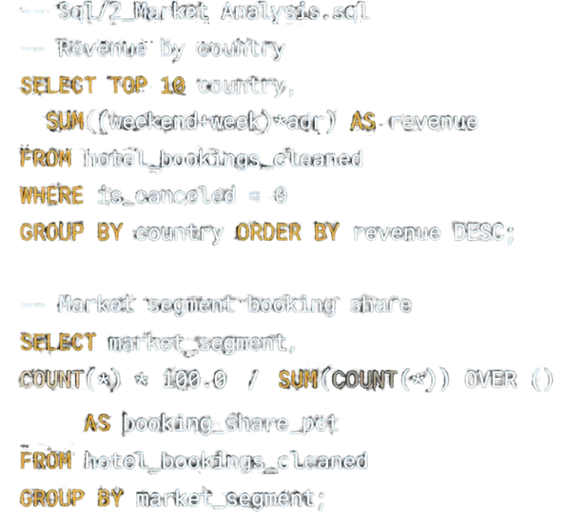







08 - SQL QUERY 2
Market Analysis — Scope
1
Top 10 countries by revenue
5
Top 10 agents by confirmed bookings
2
Revenue by market segment
6
Top 10 agents by revenue
3
Market segment booking share
7
Repeat guests by market segment
4
Cancellation rate by distribution channel
8
Average lead time by market segment
Hotel Booking Analysis - Data Analytics Project
17

Slide 18





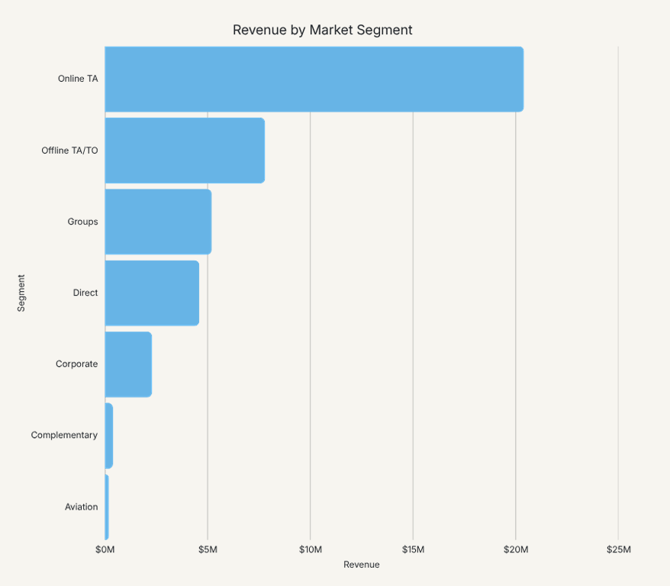
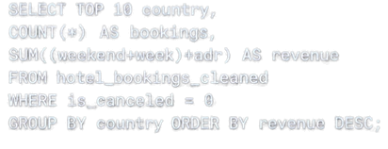
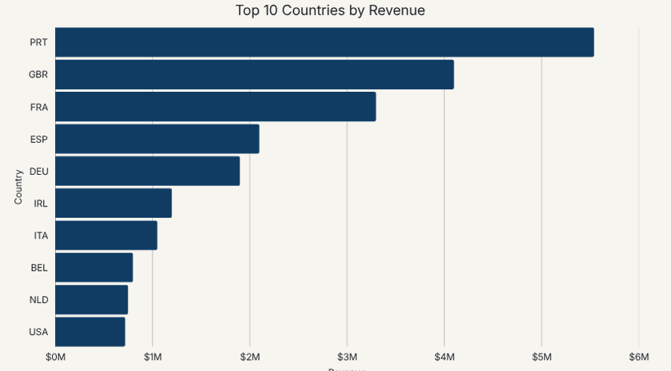
08 • SQL QUERY 2
SQL Query 2 • Questions 1
Top Countries & Market Segments
SQL QUERY
Portugal leads country revenue at -$5.54M — a home-market advantage that dwarfs the second-tier European feeder markets.
Hotel Booking Analysis • Data Analytics Project
18

Slide 19










SQL QUERY 2 • QUESTIONS 2
Top countries and market segments
02
Revenue by Market Segment
OUTPUT COLUMNS
market_segment
total bookings
total revenue
avg_adj
SQL LOGIC
SELECT
market_segment,
COUNT (*) AS
total bookings,
ROUND(SUM)
round * (stays_in_weeknight_nights + stays_in_week_nights), 2) AS total_revenue,
ROUND(AVG(adr), 2) AS avg_adj
FROM
dbo.[hotel_bookings_cleanedcsv]
WHERE
isCanceled = 0
GROUP BY
market_segment
ORDER BY
total_revenue DESC;

Slide 20
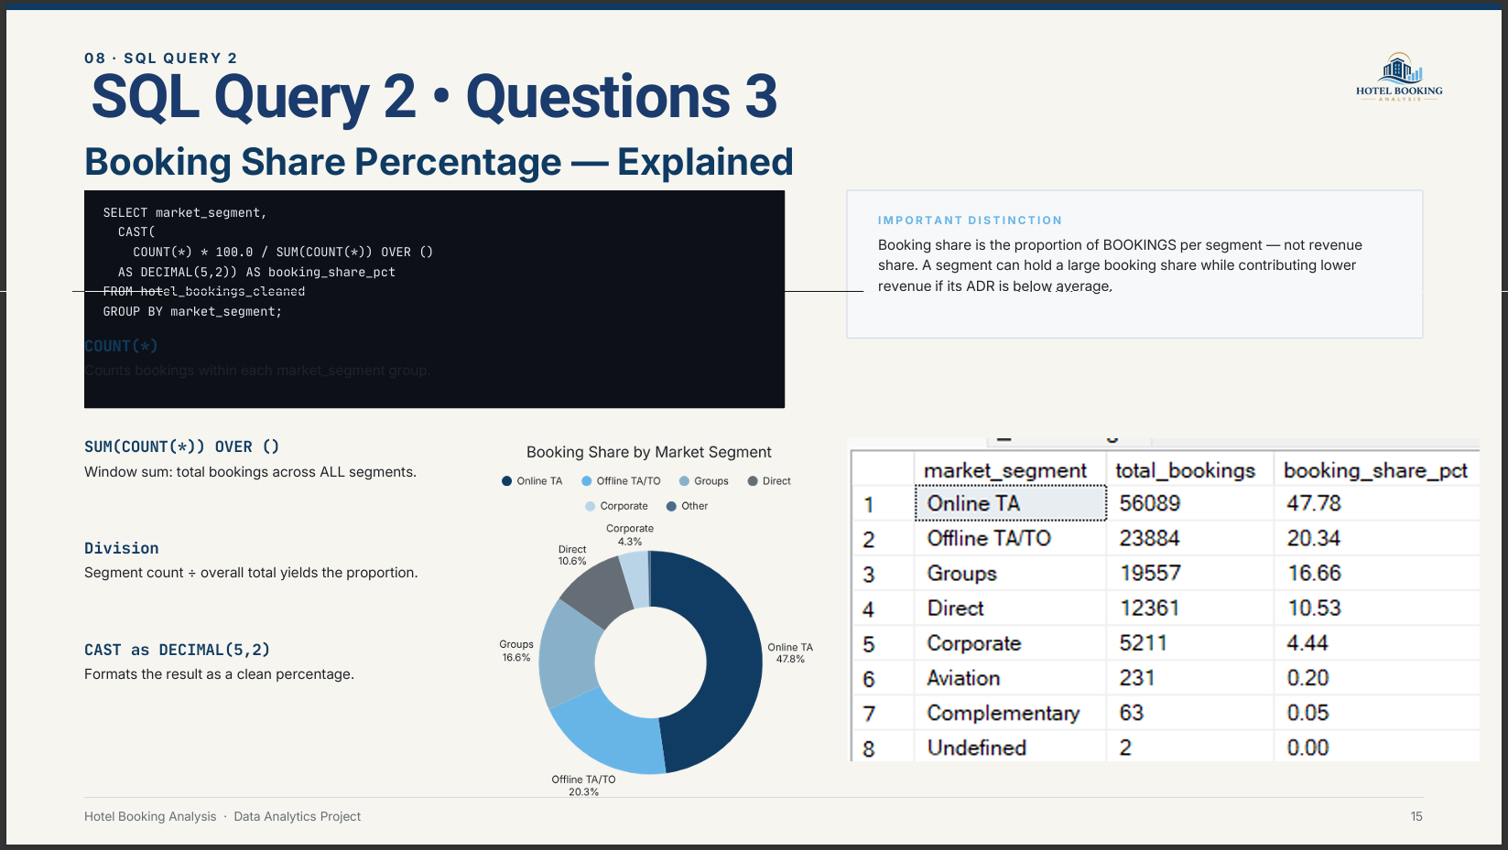

Slide 21
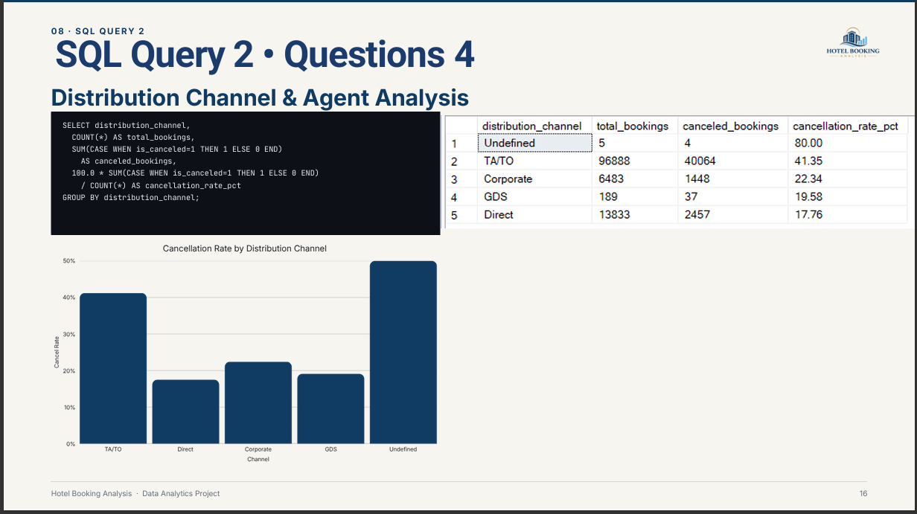

Slide 22
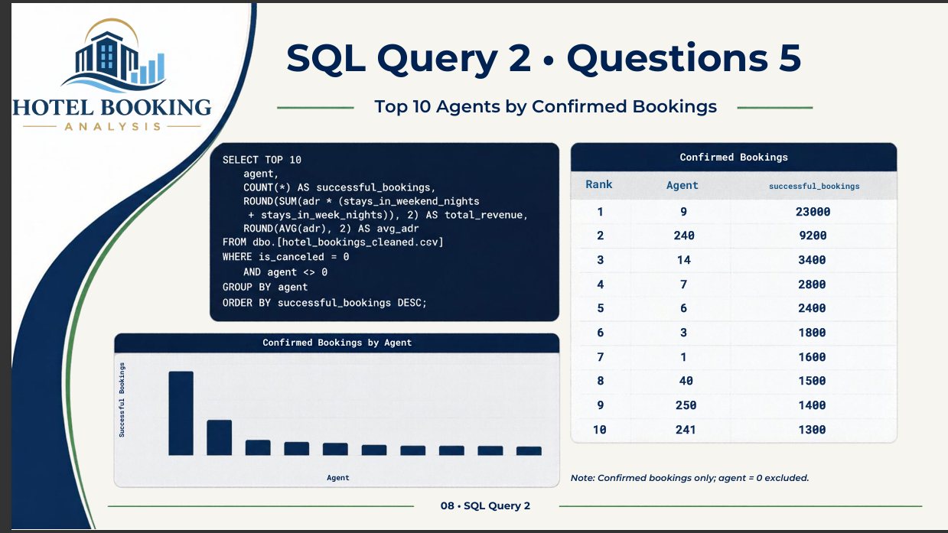

Slide 23
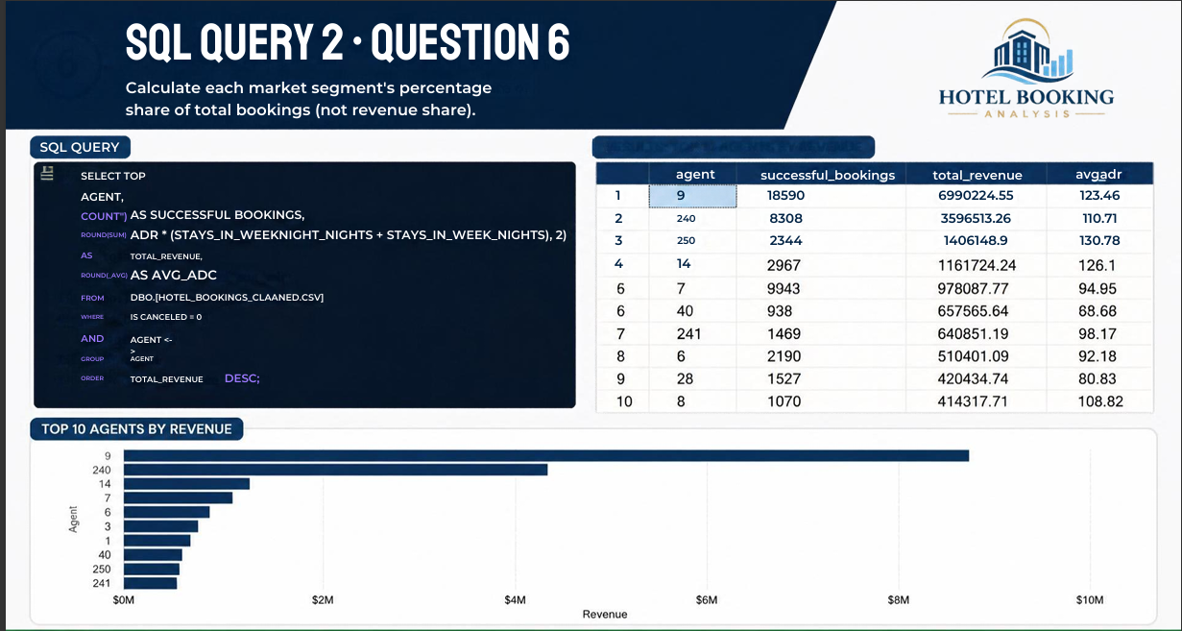
Result — Top 10 agents by revenue

Slide 24
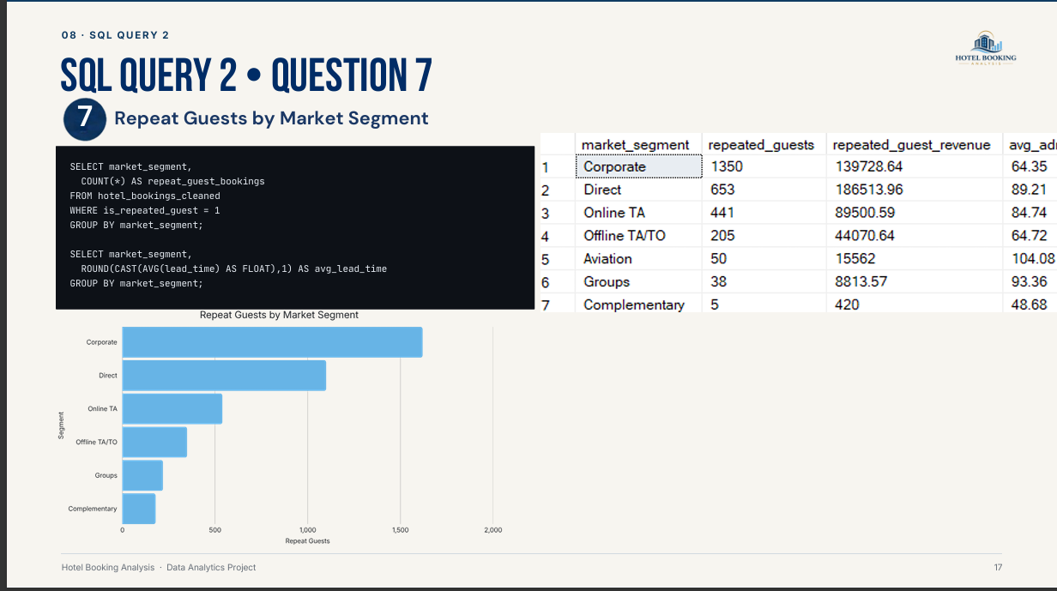

Slide 25



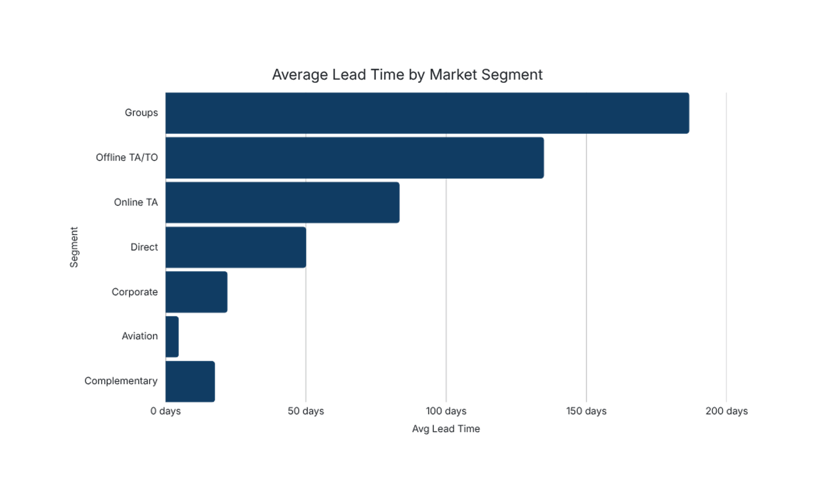

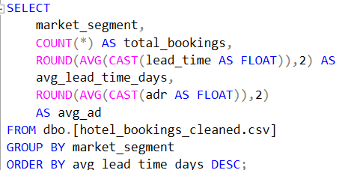
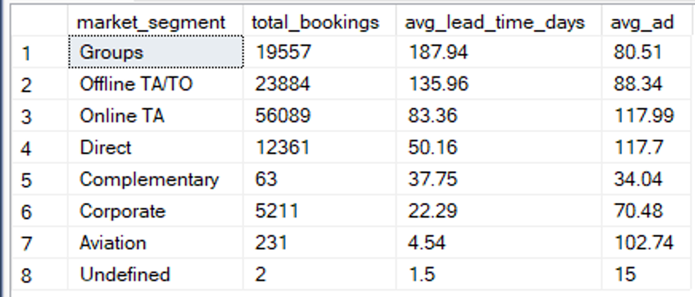
SQL QUERY 2
QUESTIONS 8
8
Hotel Booking Analysis • Data Analytics Project

Slide 26





WALID NOFAL
Marketing Analysis Using Tableau
04 / 06
From market performance to actionable business insight

Slide 27
09 · MARKETING
Marketing Analysis Overview
Marketing analysis focuses on how demand is acquired, where it originates, and how efficiently each channel converts to confirmed, revenue-generating stays.
01
02
03
TOOLING
Customer Acquisition
Market Segments
Distribution Channels
Tableau
Chosen for interactive filtering, blended data sources, and complex slicing across segment, channel, and geography.
04
05
06
Booking Volume & Revenue
Top agents
Lead Time & Repeat Guests
Hotel Booking Analysis · Data Analytics Project
19

Slide 28
09 · MARKETING
Marketing KPIs & Dimensions
01
Total Bookings
Volume of reservations across the analytic window.
02
Revenue
Realized revenue: nights × ADR on confirmed bookings.
03
Average ADR
Average Daily Rate — pricing strength per stay.
04
Booking Share
Segment's proportion of total booking volume.
05
Cancellation Rate
Canceled ÷ total, measuring channel risk.
06
Average Lead Time
Days between booking and arrival.
07
Repeat Guests
Guests with a prior stay — loyalty signal.
Hotel Booking Analysis · Data Analytics Project
20

Slide 29
09 · TABLEAU
Dashboard Walkthrough
1
Top Country
Revenue and booking counts for top 1 country
MARKETING ANALYSIS DASHBOARD
2
Market Segment
Country by Revenue
Segment Share
Total Booking share, ADR, and revenue by segment.
3
Distribution Channels
Cancellation rate and volume by channel.
4
Agent Performance
Channel Cancel Rate
Top Agents
Top agents by bookings and revenue.
5
Filters & Slicers
Date range, hotel, and segment interactivity.
Hotel Booking Analysis · Data Analytics Project
21

Slide 30
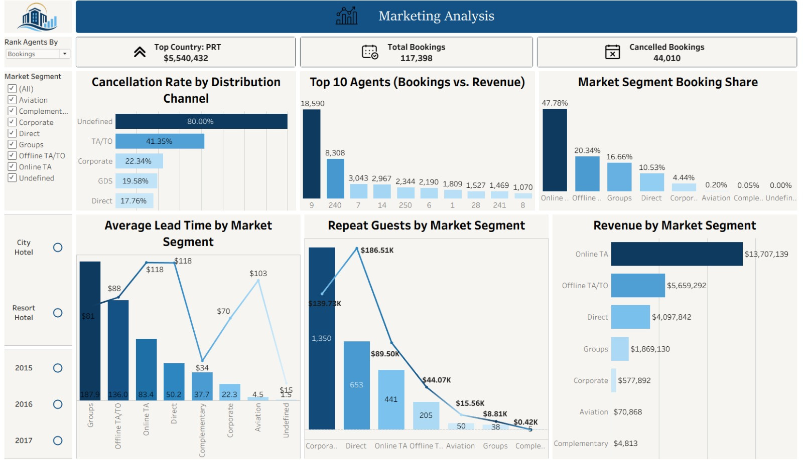
09 · MARKETING
Market Segment Analysis
22

Slide 31
08 · TABLEAU
Marketing Dashboard — Findings
Portugal
Online TA · 47.78%
TA/TO
Top country by revenue
Largest booking share
Highest cancellation rate channel
Agent 9
Groups · 186.7d
Corporate
Top agent by bookings & revenue
Longest avg lead time
Highest repeat-guest concentration
The Tableau dashboard surfaces market segment booking share, channel cancellation risk, agent performance rankings, average lead time by segment, and repeat-guest concentration — all filterable by date, hotel, and segment.
Hotel Booking Analysis · Data Analytics Project
18

Slide 32
09 · MARKETING
Marketing Insights
OBSERVED
INTERPRETATION
Portugal is the top revenue country (~$5.54M).
Home market dominates; secondary EU markets are dispersed.
OBSERVED
INTERPRETATION
Online TA holds ~47.78% booking share.
OTA reliance concentrates channel risk; direct share is smaller.
OBSERVED
INTERPRETATION
Lead time varies from ~5 days (Aviation) to ~187 days (Groups).
Segments differ in planning horizon; pricing windows must adapt.
OBSERVED
INTERPRETATION
Cancellation rates diverge by distribution channel.
Channel-specific policies (deposits, cutoffs) should be re-evaluated.
Hotel Booking Analysis · Data Analytics Project
24

Slide 33
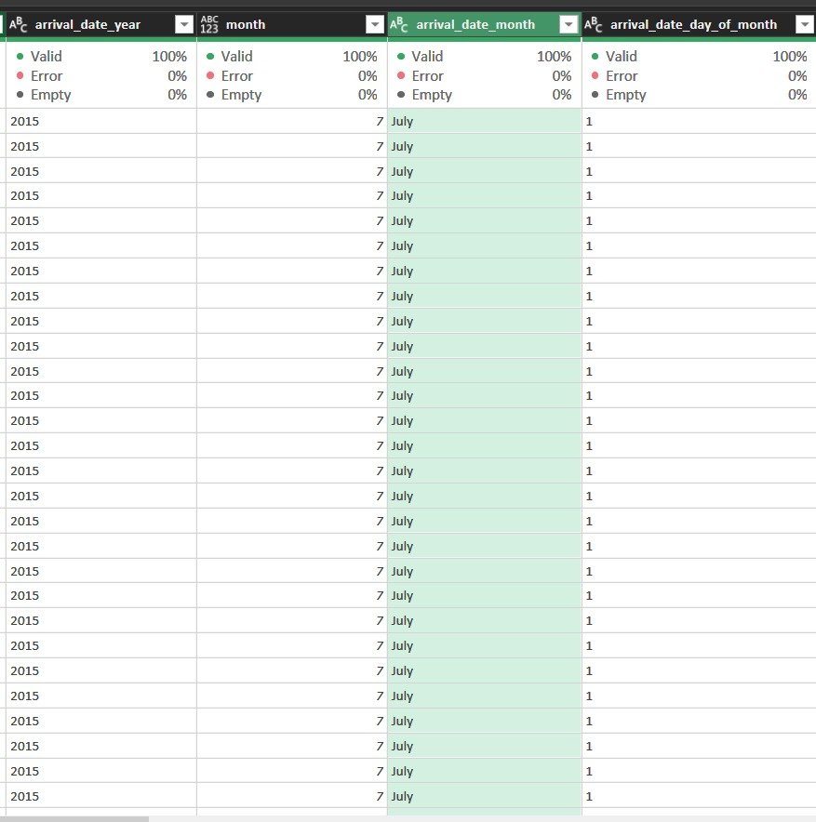
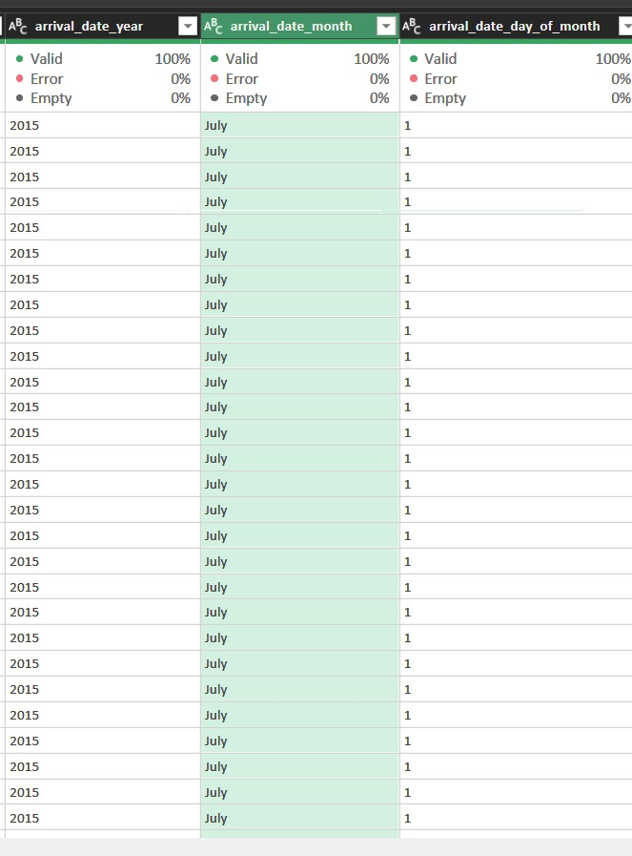
09 · Excel
Power Query
24

Slide 34
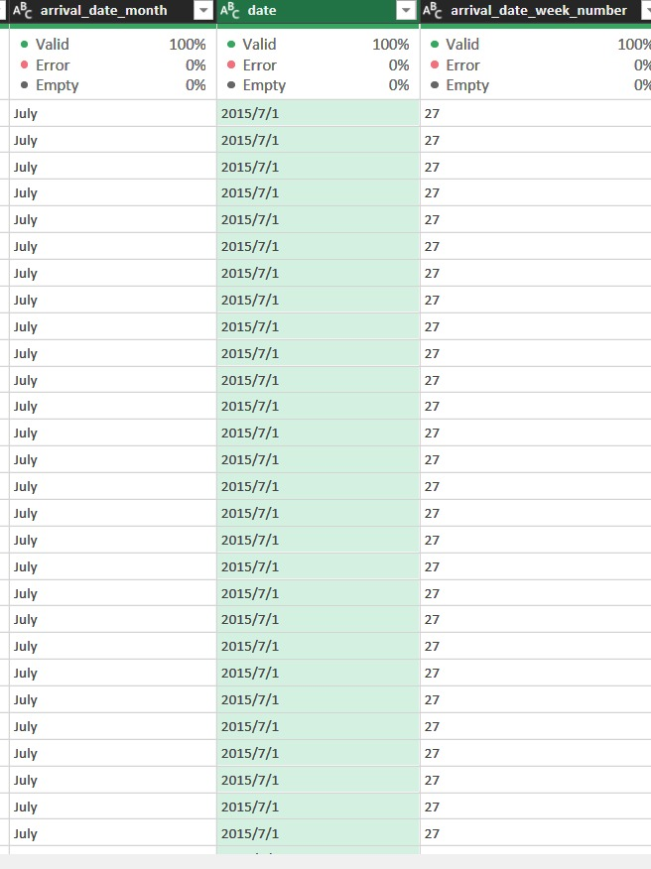
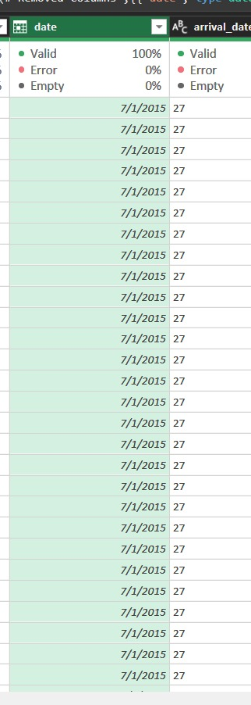
09 · Excel
Power Query
24

Slide 35





HANA MOHAMED
SQL Query 3 • Cancellation Analysis + Power BI
From cancellation patterns to operational insight

Slide 36
10 · SQL QUERY 3
Cancellation Analysis — Overview
1
Cancellation rate by lead time
6
Previous cancellation history
2
Cancellation by deposit type
7
Booking changes vs cancellation
3
By room type changes
8
Total bookings
4
By arrival month
9
Overall cancellation rate
5
Special requests vs cancellation
WHY IT MATTERS
Cancellations sit at 37.5% and translate to $16.72M in lost revenue — the single largest lever for revenue recovery and forecasting accuracy.
Hotel Booking Analysis · Data Analytics Project
25

Slide 37
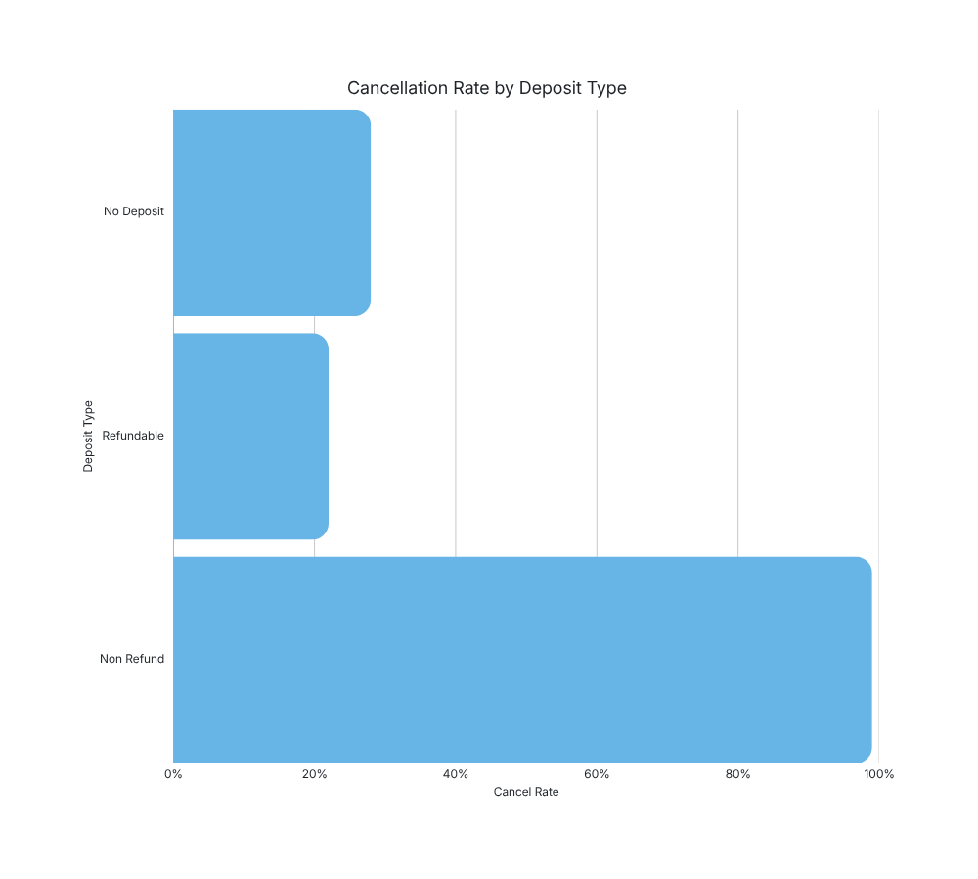
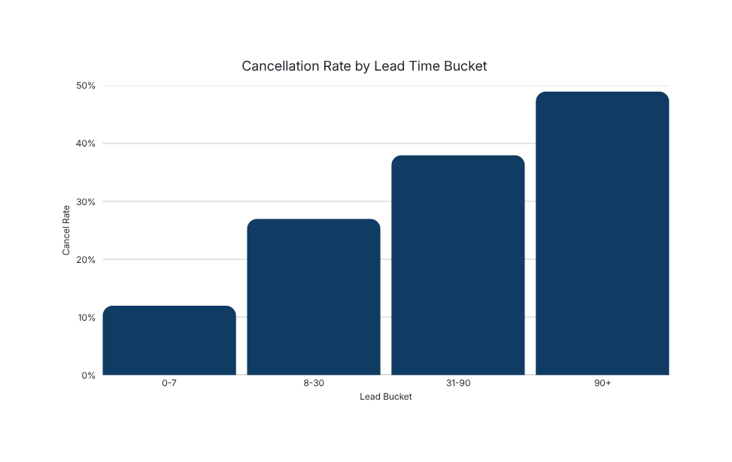
10 · SQL QUERY 3
Cancellation by Lead Time & Deposit
SELECT
CASE WHEN lead_time<=7 THEN '0-7'
WHEN lead_time<=30 THEN '8-30'
WHEN lead_time<=90 THEN '31-90'
ELSE '90+' END AS lead_bucket,
AVG(CAST(is_canceled AS FLOAT))*100
AS cancel_rate_pct
GROUP BY 1;
Hotel Booking Analysis · Data Analytics Project
26

Slide 38
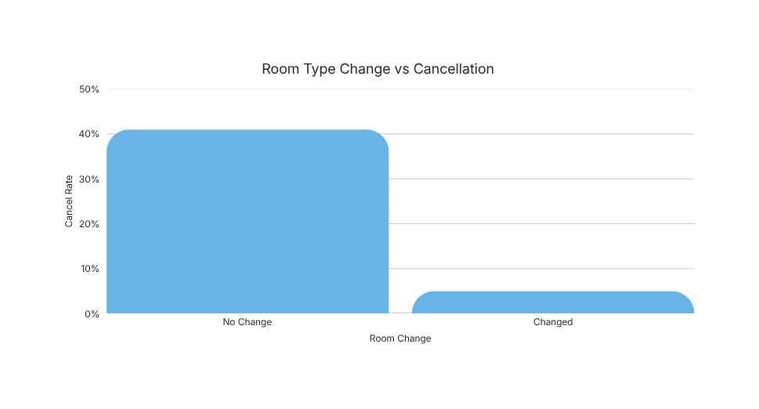
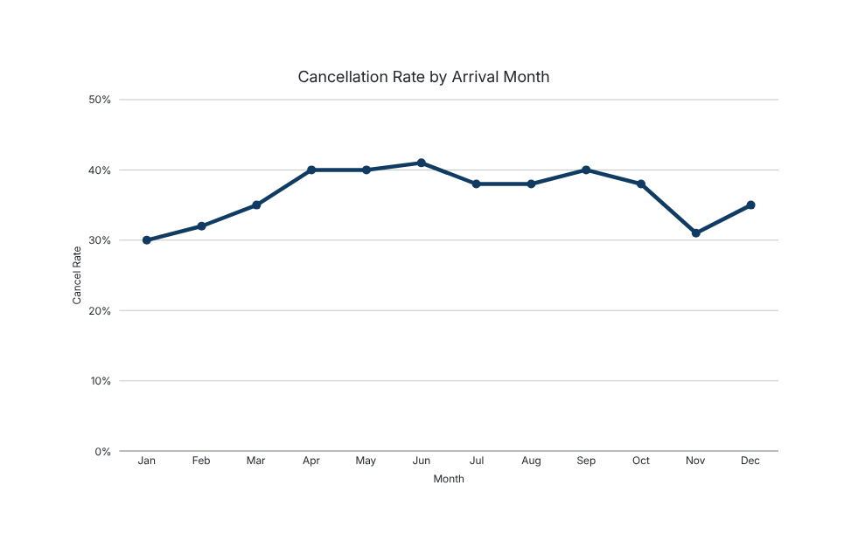
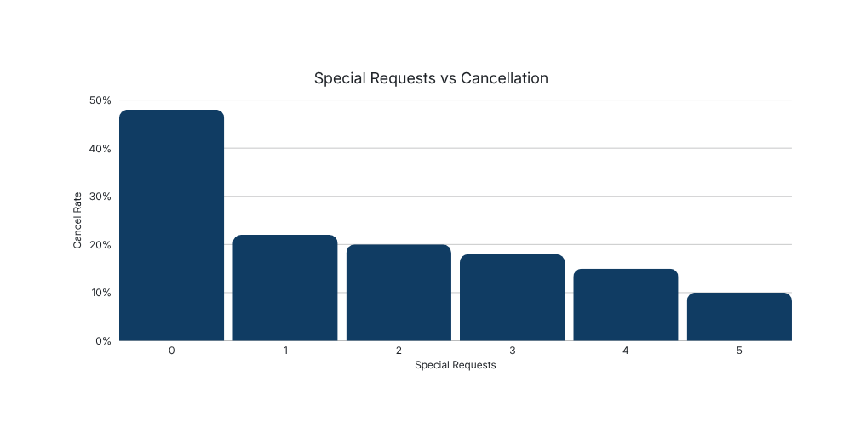
10 · SQL QUERY 3
Room Change · Arrival Month · Special Requests
SELECT arrival_date_month,
SUM(CAST(is_canceled AS INT)) AS canceled,
AVG(CAST(is_canceled AS FLOAT))*100 AS rate_pct
FROM hotel_bookings_cleaned
GROUP BY arrival_date_month;
Hotel Booking Analysis · Data Analytics Project
27

Slide 39
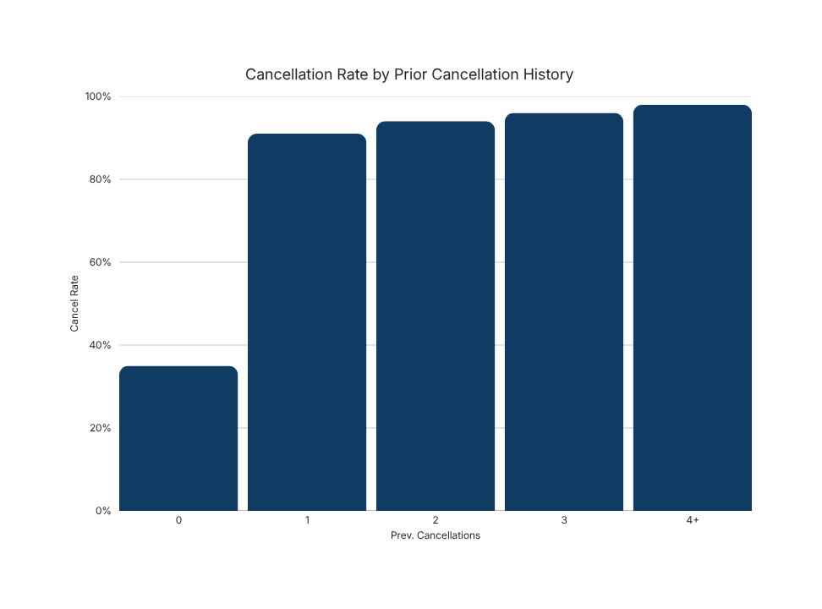
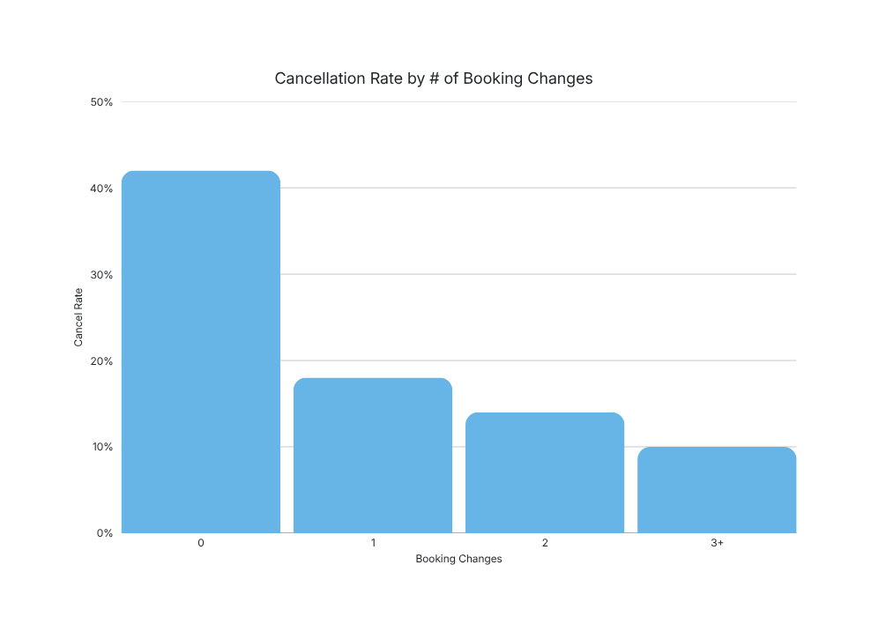
10 · SQL QUERY 3
Previous Cancellations & Booking Changes
117,398
44,020
37.5%
TOTAL BOOKINGS
CANCELLATIONS
OVERALL CANCEL RATE
Hotel Booking Analysis · Data Analytics Project
28

Slide 40
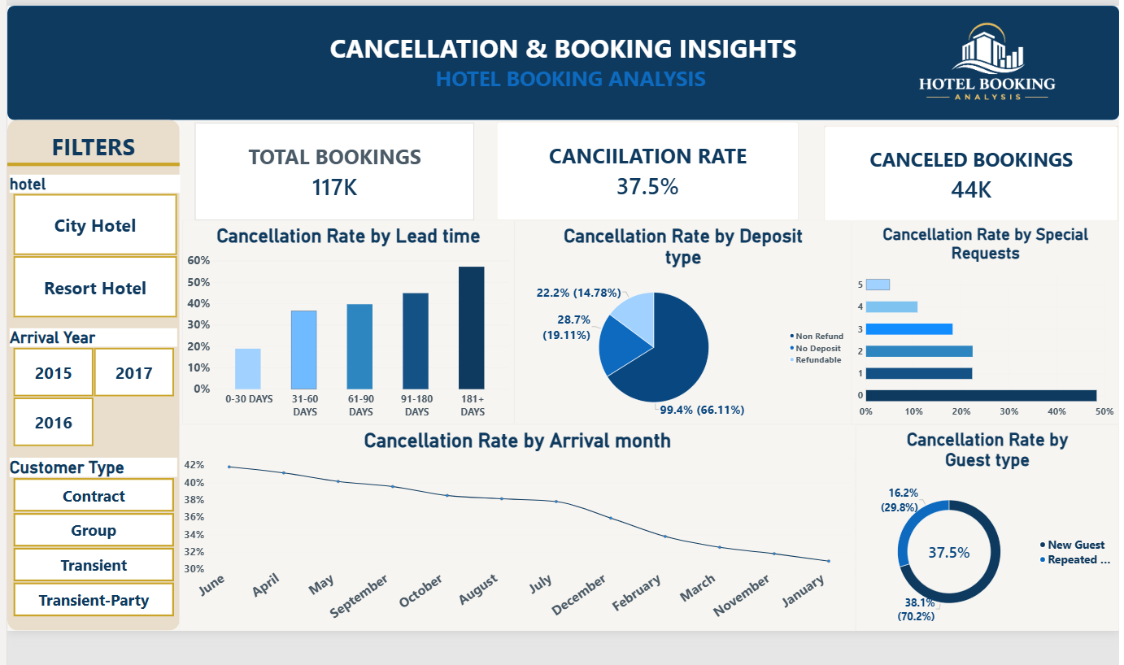
10 · POWER BI
Cancellation & Booking Dashboard
Hotel Booking Analysis · Data Analytics Project
29

Slide 41
10 · SQL QUERY 3
Cancellation Insights
OBSERVED PATTERN
POSSIBLE INTERPRETATION
Cancellation rate rises steadily with lead time.
Longer horizons mean more plan changes; deposits or reconfirmation windows can moderate risk.
OBSERVED PATTERN
POSSIBLE INTERPRETATION
Non-refundable deposits show near-universal cancellation.
Suggests these bookings may represent speculative or duplicate reservations rather than active demand.
OBSERVED PATTERN
POSSIBLE INTERPRETATION
New guests cancel more often than repeat guests.
Loyalty is a strong retention signal; repeat-guest incentives can protect volume.
OBSERVED PATTERN
POSSIBLE INTERPRETATION
Zero special requests correlate with higher cancellations.
Engagement (requests, changes) appears associated with commitment to arrival.
Hotel Booking Analysis · Data Analytics Project
30

Slide 42




EMAN ELNAHAS
SQL Query 4 • Customer Behavior + Power BI Dashboard
06 / 06
From guest behavior to
the final project takeaways

Slide 43
11 · SQL QUERY 4
Customer Behavior — Overview
Query 4 profiles who books, what they want, and how they interact with the hotel — the operational and marketing complement to revenue and cancellation analytics.
01
02
03
Guest Demographics
Preferences & Amenities
Service Intensity
04
05
06
Booking Changes
Room Discrepancies
Loyalty & Repeat
Findings inform staffing plans, amenity investment, loyalty programs, and targeted marketing campaigns.
Hotel Booking Analysis · Data Analytics Project
31

Slide 44
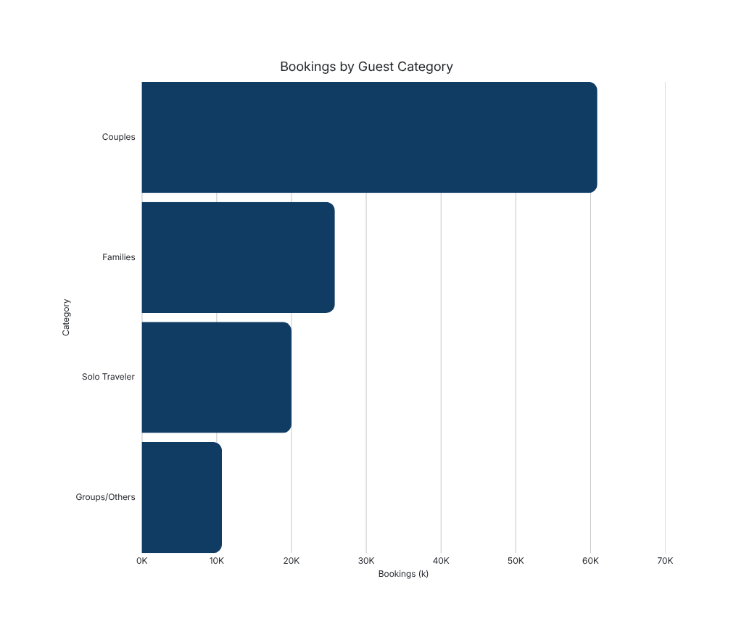
11 · SQL QUERY 4
Guest Demographics
SELECT
CASE
WHEN adults=1 AND children=0 AND babies=0
THEN 'Solo Traveler'
WHEN adults=2 AND children=0 AND babies=0
THEN 'Couples'
WHEN children>0 OR babies>0 THEN 'Families'
ELSE 'Groups/Others'
END AS guest_category, ...
GROUP BY guest_category;
Couples
Families
52%
60,900 bookings
22%
25,800 bookings
Avg stay: 3.4 nights
Avg stay: 4.1 nights
Solo
Groups/Others
17%
20,000 bookings
9%
10,700 bookings
Avg stay: 2.8 nights
Avg stay: 2.6 nights
Hotel Booking Analysis · Data Analytics Project
32

Slide 45
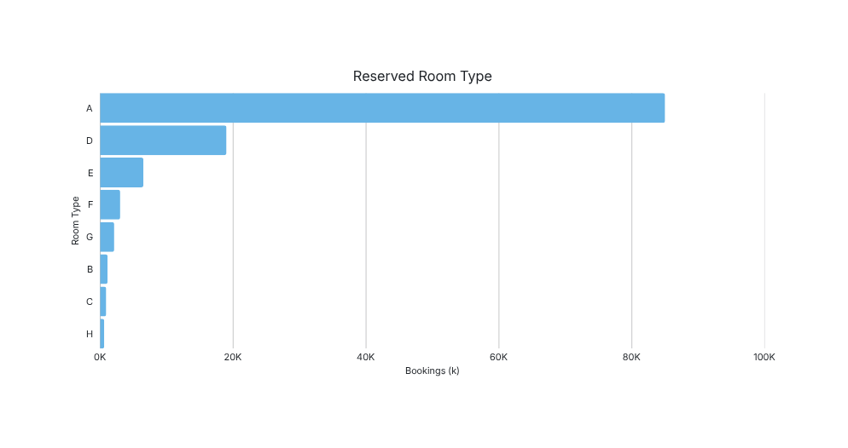
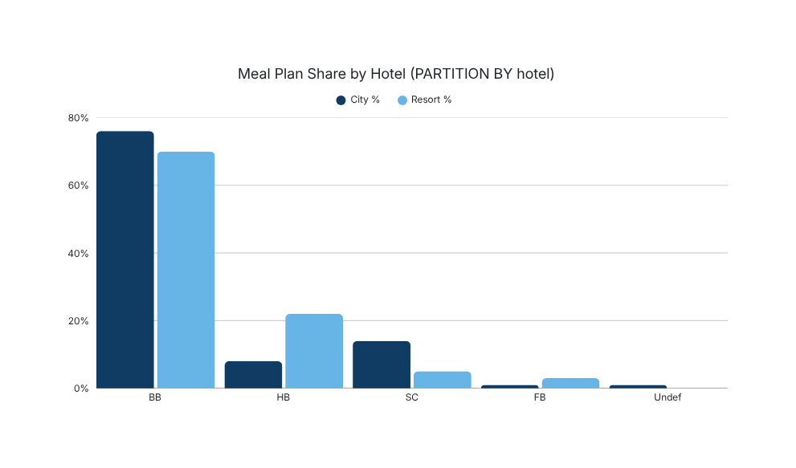
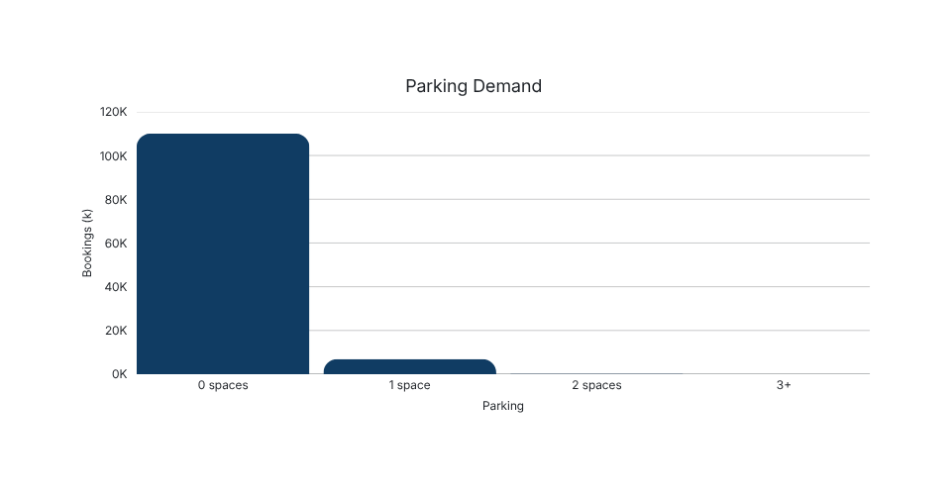
11 · SQL QUERY 4
Guest Preferences & Amenities
SELECT hotel, meal,
COUNT(*) AS bookings,
100.0 * COUNT(*)
/ SUM(COUNT(*)) OVER (PARTITION BY hotel)
AS meal_share_pct
GROUP BY hotel, meal;
PARTITION BY hotel isolates each property's mix — so a City breakfast share is not diluted by Resort half-board volume.
Hotel Booking Analysis · Data Analytics Project
33

Slide 46
11 · SQL QUERY 4
Service Intensity & Operations
SELECT hotel,
AVG(total_of_special_requests) AS avg_requests,
100.0 * SUM(CASE WHEN booking_changes>0
THEN 1 ELSE 0 END) / COUNT(*)
AS change_rate_pct,
100.0 * SUM(CASE WHEN reserved_room_type
<> assigned_room_type
THEN 1 ELSE 0 END) / COUNT(*)
AS room_discrepancy_rate_pct
GROUP BY hotel;
0.57
AVG SPECIAL REQUESTS / GUEST
14.5%
BOOKING CHANGE RATE
18.14%
ROOM DISCREPANCY RATE
Room discrepancy — reserved type ≠ assigned type — is a leading indicator of on-property operational friction and guest satisfaction risk.
Booking-change rate captures how often guests modify reservations before arrival, a proxy for engagement and reduced cancellation risk.
Hotel Booking Analysis · Data Analytics Project
34

Slide 47
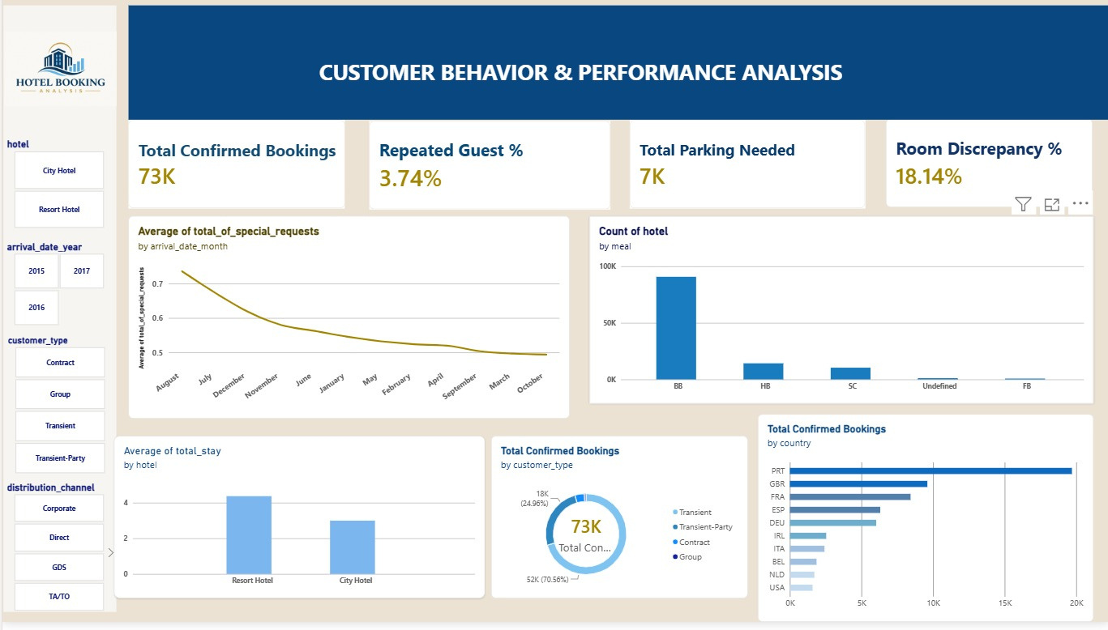
11 · POWER BI
Customer Behavior Dashboard
35

Slide 48
FINAL INSIGHTS · END-TO-END PIPELINE
COMPLETE PROJECT PIPELINE
From raw records to business insight.
RAW DATA
PYTHON EXPLORATION
CLEANING
FEATURE ENG
SQL
POWER BI
TABLEAU
INSIGHTS
REVENUE
MARKETING
CANCELLATION
BEHAVIOR
$42.7M realized · $16.7M lost
OTA-heavy · Portugal top origin
37.5% overall · lead time driven
18% room discrepancy · low repeat
Thank You
Karima Saad · Nourhan Wael · Elsayed Elsawaf · Walid Nofal · Hana Mohamed · Eman Elnahas

